Slide 1



Introduction to Scala

Slide 2

Learning Objectives
Why Scala?
Features and Advantages of Scala
OOPS and Functional Paradigm
Data Types and Variables
Execution of Scala Code
Looping Constructs
Collection

Slide 3




Why Scala?
Why Scala? when we have other wonderful languages like Java, Python…..
Ease of Code
A Wonderful blend of OOPS and Functional paradigm
A JVM compliant language
Statically Typed
Scalable - Architecture
Lets talk about these features and advantages in detail in
next slides ……..

Slide 4

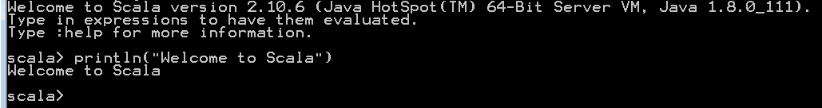
Ease of Code
We don’t need to write a function or class in order to evaluate our code.
Scala terminal gives us wonderful features to evaluate our code/scripts.
Scala REPL (“Read-Evaluate-Print-Loop”) command line interpreter, eases the code development .
Lets see how to work with Scala REPL ……….

Slide 5

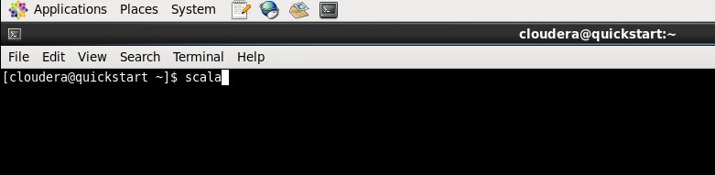

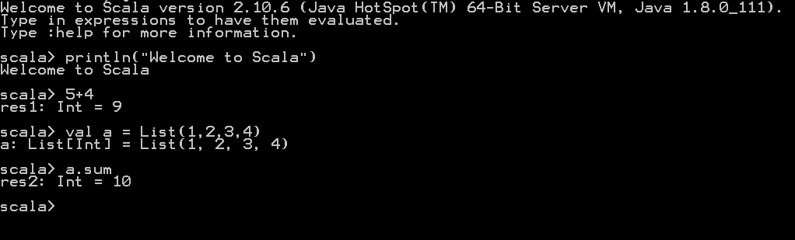
Scala REPL(Read Evaluate Print Loop)
To start the Scala REPL, type scala in operating system command line:
This will open, scala REPL environment, where we can try all sorts of different experiments and expressions:

Slide 6











OOPS and Functional
Scala fully supports Object-Oriented Programming (OOP).
Every thing in Scala is treated as an Object
Supports all OOPS concepts like Abstraction, Encapsulation, Inheritance and Polymorphism
OOPS
Method Overriding
Method Overloading
Classes
Inheritance
Functions
Constructors
Traits

Slide 7





OOPS and Functional (cont..)
Scala fully supports Functional Programming (FP).
Functional Programming is the best approach to program in development environment in Big Data space.
FP
Higher Order
Funtions
Anonymous
Functions
Currying
Functions
Closures

Slide 8

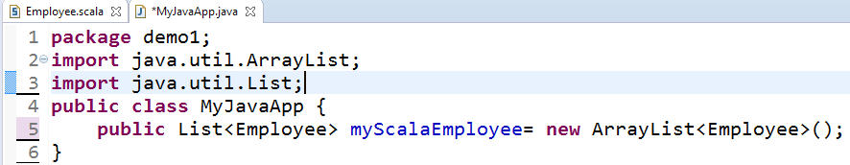

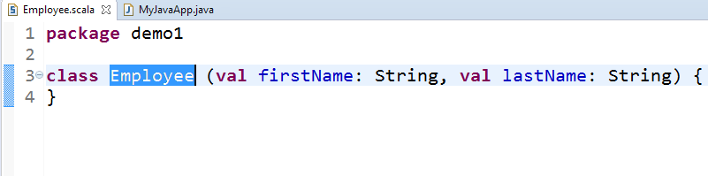
JVM Compatible
Scala runs on JVM.
Scala code is compiled and converted into byte code which ultimately runs on JVM.
Scala and Java code can easily be combined in a single project.
There are
two
Scala
classes class
above. whereas
“Employee” is
“MyJavaApp” is a Java Class. It is evident that we can use Employee objects in Java application.

Slide 9


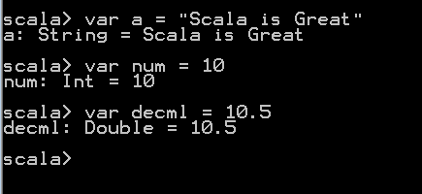



Scala: Statically Typed
Scala is statically typed.
It implies that Scala has the ability to implicitly infer the data type.
It uses type inference to eliminate much of the typing boilerplate.
We can see that even if we don’t specify the variable type, automatically.
Scala
interprets
the data
type
String Type
Integer Type Double Type

Slide 10


Scala: Scalable - Architecture
Scala can be used to:
Write small scripts for ad-hoc development
Write distributed applications for Big Data space.
Spark a distributed processing framework is written in Scala

Slide 11


Scala Installation
We can install Scala on our Windows or Linux systems.
Java should be installed before installing Scala.
Verify the version of Java with java - version command.
Download Scala binaries from https://www.scala-lang.org/download/
Download the tar file for your respective OS and untar it at desired location.
For Windows, there is a Windows Installer also available on https://www.scala-lang.org/download/

Slide 12
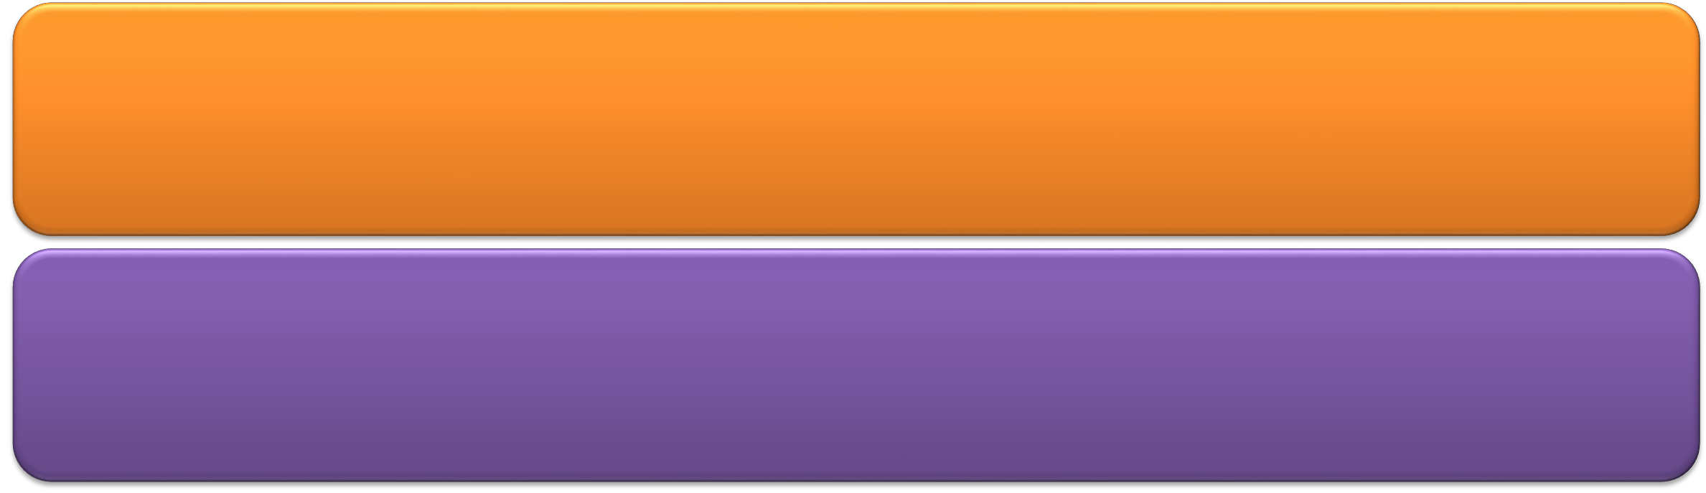
Variables in Scala
Variables are reserved memory locations to store values. All variables in Scala are Object types as Scala in
purely Object Oriented.
There are two types of variables in Scala:
Immutable: An immutable object is an object whose state cannot be modified after it is created. This implies that the value of such variables cannot be changed once assigned.
Mutable: A mutable variable can be modified after it is created.

Slide 13


Variables in Scala
Declared with val keyword. Reassignment to val will return an error.
scala> val msg = "Hello Scala"
msg: String = Hello Scala scala> msg = "Hello Spark"
<console>:8: error: reassignment to val
Immutable
Declared with var keyword.
Can be reassignment to new value.
scala> var msg = "Hello Scala" msg: String = Hello Scala scala> msg = "Hello Spark" msg: String = Hello Spark
Mutable

Slide 14

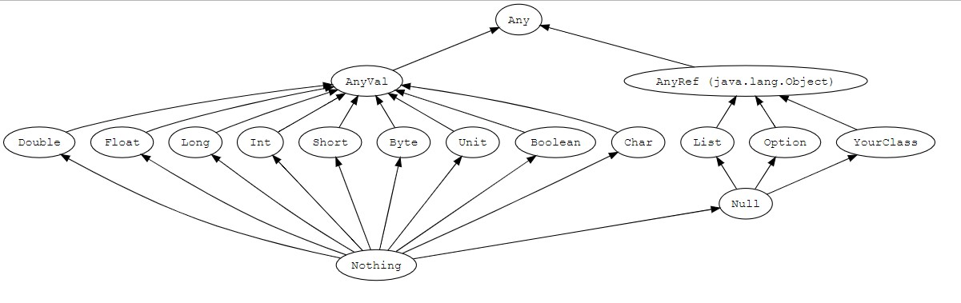
Scala Data Types
Scala has data types similar to Java with same memory allocation and precision.
All values have a type in Scala. All numeric, string and even functions have a type attached to it.

Slide 15

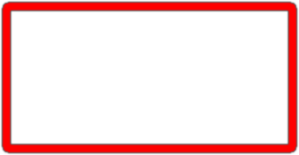
Scala Data Types (cont..)
Any is the supertype of all types, also called the top type.
Any has two direct subclasses: AnyVal and AnyRef.
AnyVal represents value types e.g. Double, Float, Long, Int, Short, Byte, Char, Unit, and Boolean.
AnyRef represents reference types.

Slide 16



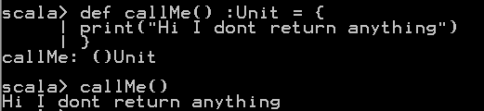
Data Types: Gotcha - Unit & Nothing
Unit and Nothing types have always been confusing. Lets understand them.
Unit:
Is not represented by any object in the underlying runtime system.
A method with return type Unit is
analogous to a Java method which is declared void.
There is only one value of type Unit, ()

Slide 17

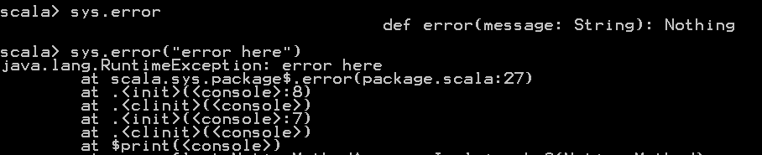
Data Types: Gotcha - Unit & Nothing
Nothing:
Nothing is a subtype of every other type (including Null).
It has no value but Unit has exactly one value i.e. ‘()’
Nothing means that there was an error and nothing was returned. For example an Exception
situation.
The package object scala.sys contains a method called error() that returns Nothing.
Reference: https://www.scala-lang.org/api/2.9.1/scala/sys/package.html

Slide 18
Data Types: Option, Some & None
Option type Represents optional values.
Instances of Option are either an instance of scala.Some or the object None.
Class scala.Some[T] represents existing values of type T.
The None object represents non-existent values.
Example: Suppose we have a method that retrieves product record from the database based on
productId.
Return Type
Method:→ getProduct (productId: Int): Option[Product]
Here Option[Product] is the return type of method, if there exists a record for a particular productId then it will return Some[Product] else None

Slide 19


Multi Variable Assignment
Scala supports multiple variable assignments in a single statement.
Assigning two variables using Pair:
Assigning more that two variables:
scala> val (myvar1, myvar2) = Pair(25, "hello") myvar1: Int = 25
myvar2: String = hello
scala> val (myvar1, myvar2, myvar3, myvar4) = (10,20.5,"hello",1000000000000L) myvar1: Int = 10
myvar2: Double = 20.5
myvar3: String = hello
myvar4: Long = 1000000000000

Slide 20

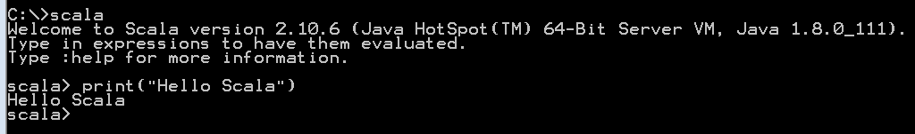
Executing Scala Code
Once we have installed Scala, we can run code in different ways:
Scala Terminal: If Scala in installed and its path is set in system environment variable, then we can execute the Scala code in Scala terminal by following below steps:
Open your terminal
Type Scala and press Enter
2. Using an IDE: You can use any Scala IDE like Intellij or Eclipse.
New versions of Eclipse come with inbuilt Scala plugin for executing Scala code. For older versions, Scala IDE plugin can be installed in Eclipse

Slide 21

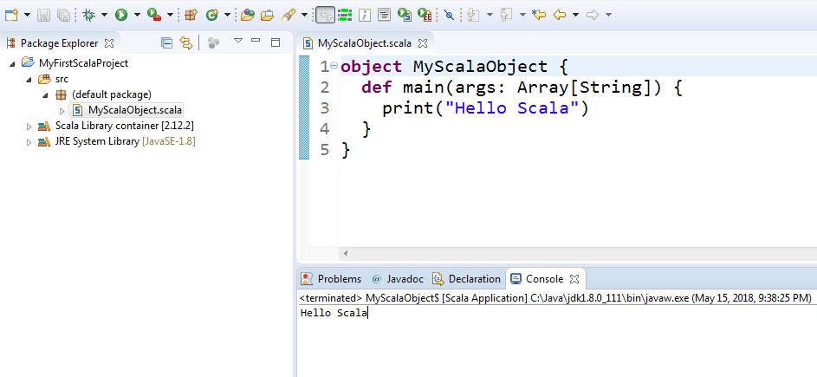
Advantages of Scala IDE
Gives integrated environment for both Scala and Java developments.
Increases productivity Auto code completion Easy debugging of code

Slide 22


If…else Statement
An if statement can be followed by an optional else statement, which executes when the Boolean expression is false.
The syntax of an if…else is:
if(Boolean_expression) {
//Executes when the Boolean expression is true
} else {
//Executes when the Boolean expression is false
}
An if statement can also be followed by an optional else if...else statement
var age = 18 if(age>=18) { print(“Can vote”)
} else {
print(“Cant vote”)
}

Slide 23


Scala Loops
Scala provides following loops:
while
do-while
for
1. while loop: repeats enclosing statements until the given condition is false.
while(condition){ statement(s)
}
var x = 5;
// starting while loop while( x < 10 ){
println( "Value of x is: " + x) x = x + 1;
}

Slide 24


Scala Loops (cont..)
2. do-while loop: while loop first checks the condition then executes the statements whereas do-while loop first executes the statements and then checks the condition. This means do-while loop will execute the enclosing statement at least once even if the condition id false.
do {
statements
}
while(condition)
var x = 5;
// starting while loop
do {
println( "Value of x is : " + x) x = x + 1
} while( x > 10 )

Slide 25


Scala Loops (cont..)
3. for loop: executes the enclosed statements until a certain range.
for( var start <- Range ){
statements
}
for( x <- 1 to 5){
println( "Value of x is: " + x )
}

Slide 26

Scala Loops (cont..)
for loop with yield: Values from for loop, can be returned and stored using yield keyword.
var yieldedValue = for{x <- 1 to 10 if x >=5 } yield x
println(yieldedValue)
Output: Vector(5, 6, 7, 8, 9, 10)

Slide 27
Scala Collections
Scala collections are distributed in two types i.e. mutable and immutable collections.
A mutable collection can be updated. This means you can change, add, or remove elements in an existing collection.
Immutable collections’ elements cannot changed. If we try changing then we get a whole new
collection object.
All mutable and immutable collection are found in scala.collection.mutable and
scala.collection.immutable packages respectively.

Slide 28


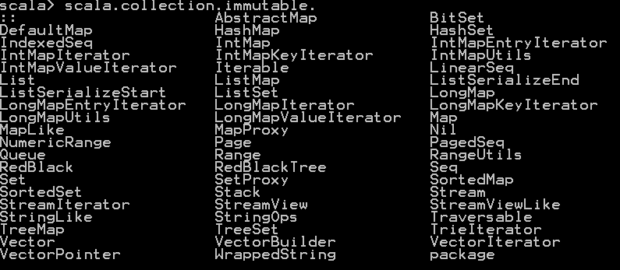
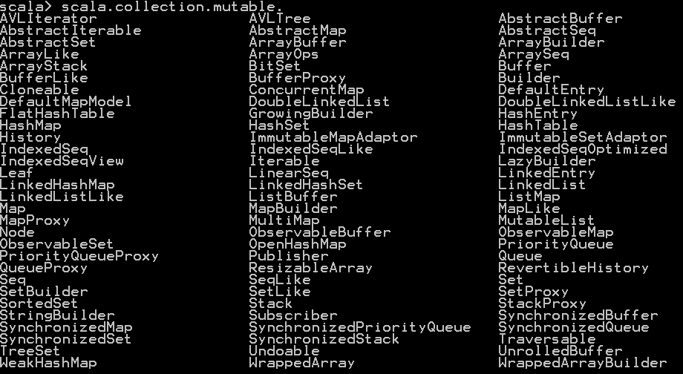
Scala Collections
There are many collections available in Scala. We will learn most frequently used collections.

Slide 29


Arrays
Arrays are mutable, indexed and fixed-size collections of values.
Array declaration and initialization:
var myArray:Array[Int] = new Array[Int](5)
OR
var myArray:Array[Int] = new Array[Int](5)
Output: myArray: Array[Int] = Array(0, 0, 0, 0, 0)
In above example, since the Array type is Int, all the values have been initialized with zero. We can also declare and initialize in a single statement.
scala> var a = Array(1,2,3,"4")
Output a: Array[Any] = Array(1, 2, 3, 4))

Slide 30

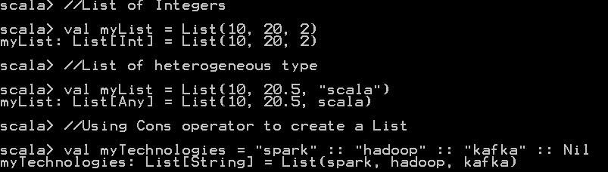


Lists
A List is an immutable sequence of elements.
Internally it is linked lists representation of ordered collections of elements of type Any.

Slide 31

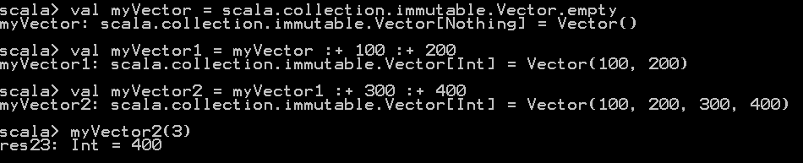
Vectors
List loses its efficiency when random access and modifications are made after the head element.
Vector addresses this inefficiency of random access in Lists.

Slide 32

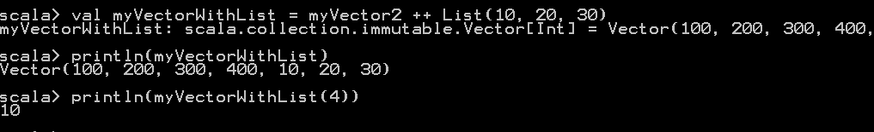
Vectors (cont..)
Adding existing List to Vector.
Manipulating Vector element.

Slide 33

Maps
Map is a collection of key - value pairs.
Keys are unique in a Map.
We have Immutable and Mutable, both varieties of Map.

Slide 34

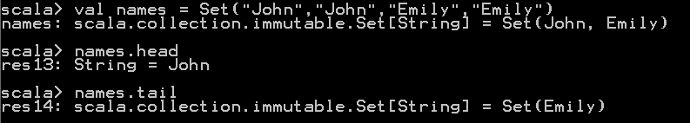
Sets
Set is a collection of different elements of the same type.
It cannot contain duplicate elements.
Like other collections, Sets are also immutable and mutable.

Slide 35


Tuples
Unlike other collections, tuples can contain element of different types.
Tuples have a limit of elements that they can contain.
We can have 22 different type of elements stored in a tuple.
Tuple can be declared an initialized using two ways:

Slide 36
Summary
Scala is a blend of functional programming and OOPS programming.
Scala is statically typed.
Scala has two types of objects:
Mutable
Immutable
Values from for loop, can be returned and stored using yield keyword.
All mutable and immutable collection are found in scala.collection.mutable and
scala.collection.immutable packages respectively.

